Slide 1
Build a unified batch and streaming pipeline with Apache Beam on AWS
Team or presenters name
Wednesday, July 21, 2021

Slide 2





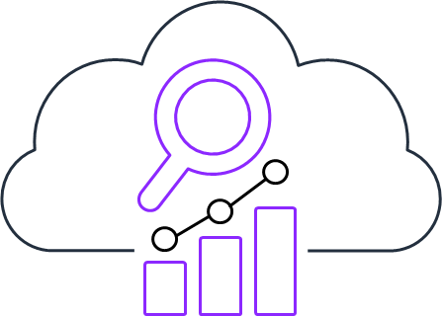
Real-time streaming on AWS
Easily collect, process, and analyze video and data streams in real time
Kinesis Data Streams
Kinesis
Data Firehose
Kinesis
Data Analytics
Managed Streaming for Kafka
Kinesis
Video Streams
Collect and store data streams for analytics
Load data streams into AWS data stores
Analyze data streams with Flink or SQL
Collect and store data streams for analytics
Capture and store video streams for analytics

Slide 3





Processing Streams with Apache Flink
Apache Flink is an open source framework and distributed engine for processing bounded (batch) and unbounded data streams at scale
Diverse use-cases
Expressive APIs
Processing guarantees
Scale-out architecture
Community
Event-driven Applications
Streaming Analytics & ETL
Batch Analytics
SQL
Table API
DataStream API
Stateful Functions
Exactly-once state consistency
Event-time processing
Late data handling
Adapt to desired throughput
Support for TBs of state
Vibrant open source community
Broad set of connectors

Slide 4

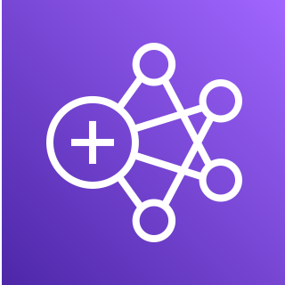

Processing streams with Apache Flink
Apache Flink is an open source framework and distributed engine for processing bounded (batch) and unbounded data streams at scale. Customers run Apache Flink on AWS on different services with varying degrees of flexibility and management.
Amazon Kinesis Data Analytics
Amazon EMR
Amazon Elastic Kubernetes Service (Amazon EKS)

Slide 5
Kinesis Data Analytics is a fully managed Apache Flink service
Amazon EKS
Amazon EMR
Amazon Kinesis Data Analytics
Flexibility with less management
Flexibility with some management
Focus on streaming application development and optimization
Fine grained infrastructure control
Cluster management
Serverless applications
Flexible infrastructure choices
Control Apps with simple API’s
More focus on creating Streaming Applications than
managing infrastructure
Fine-grained access control
Self Managed Apache Flink
AWS Managed Apache Flink
Optimized for cost
Fully managed application state
No K8s control plane to manage
Managed instances
No infrastructure management
Build-in auto scaling
Simple and secure setup

Slide 6
What Kinesis Data Analytics does for you
Rapidly create, test, deploy, and scale real-time data streaming applications
Drives best practices through design, defaults, and automation
Allows developers to focus more on application development and less on Flink infrastructure management
Enables monitoring of streaming Flink pipelines and powerful integrations with AWS services

Slide 7
Workshop
Subtitle

Slide 8

Analyzing NYC Taxi Trips
Photo by Afif Kusuma on Unsplash
Notes:
When using a full bleed photo, please put a 75% transparent squid ink overlay to ensure the title can be read.

Slide 9


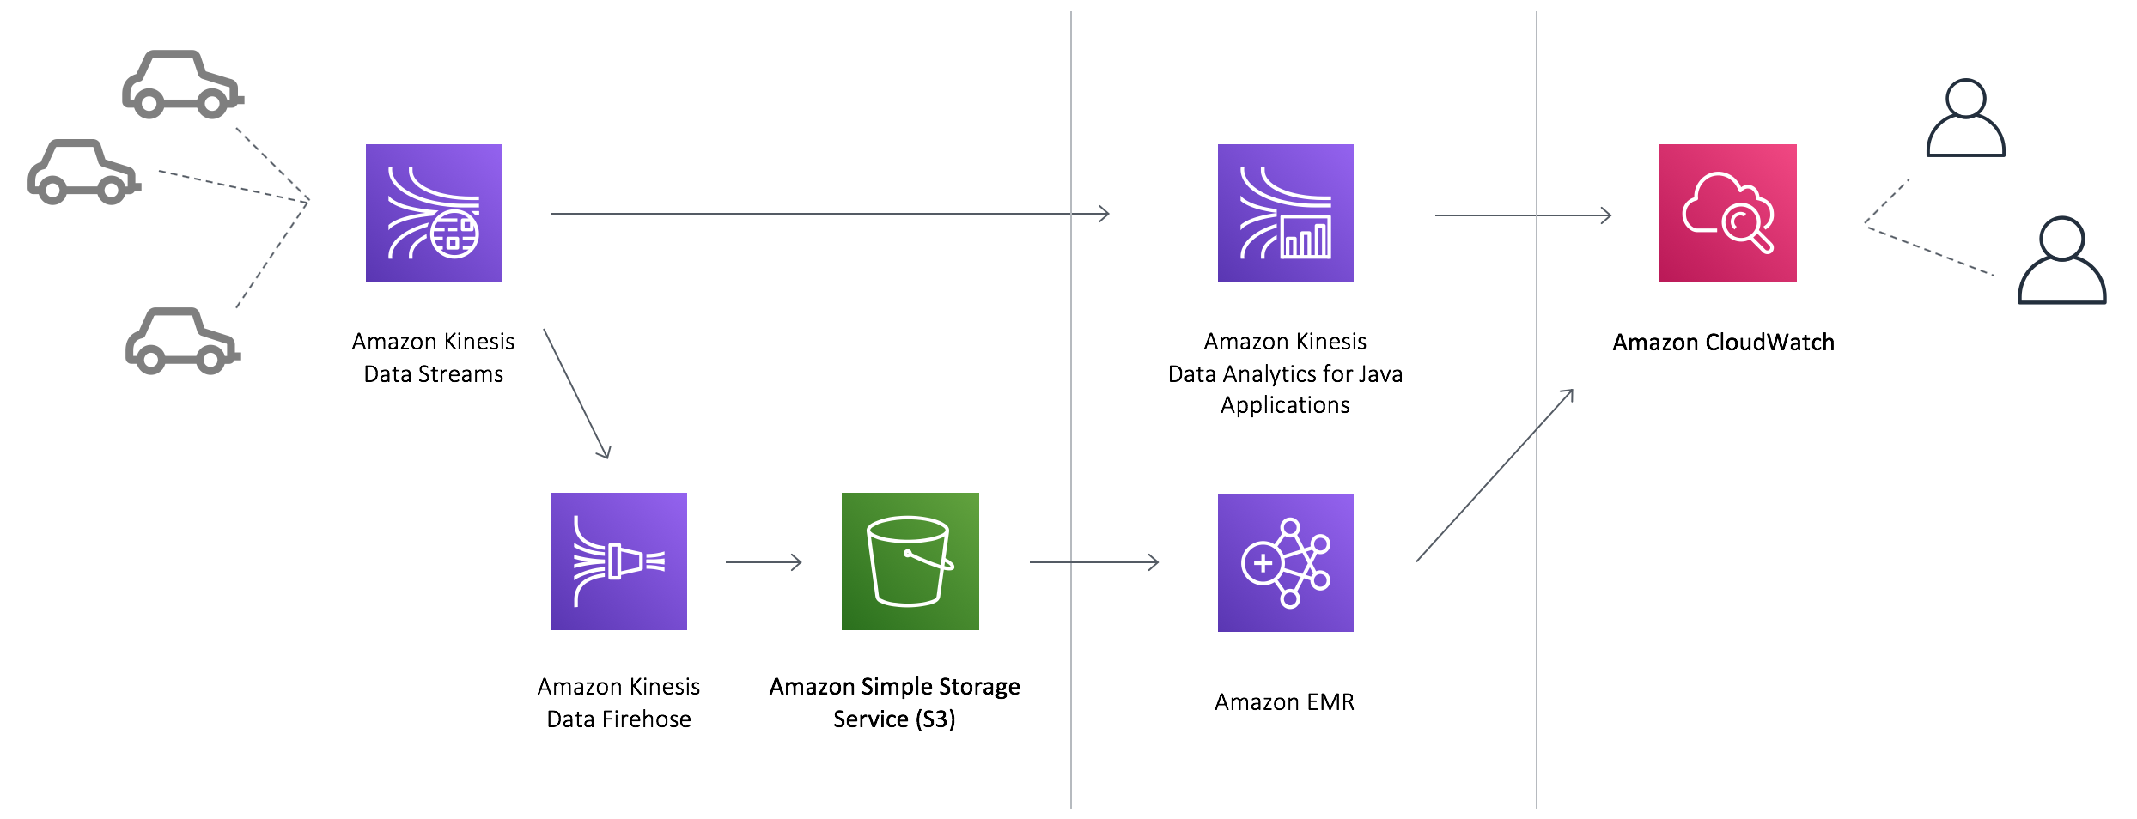
Architecture to unify batch and streaming
Ingest
Process
Present
Notes:
https://flink.apache.org/material.html
https://beam.apache.org/community/logos/

Slide 10

Event time semantics
The Apache Flink operators determine the current time by using information from the data itself. Results in computation of deterministic results even when events arrive out of order.
Unify bounded and unbounded pipeline using the same timestamp
Each event that is persisted in the Kinesis stream is automatically assigned an approximate arrival timestamp in the event meta data.
The Lambda function is simply adding the approximate arrival timestamp from the meta data into the payload of the message when it is written to Amazon S3.
Approximate Arrival Time
Enrichment

Slide 11
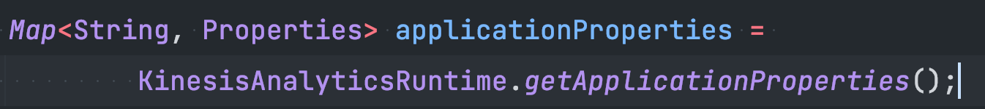
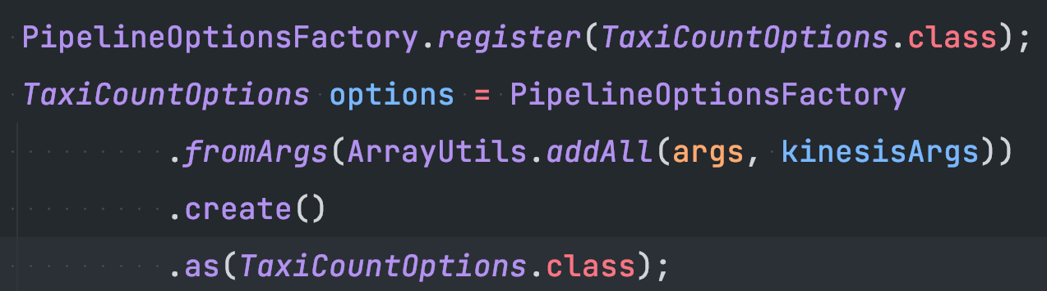
Application parameters

Slide 12
Let’s build
https://streaming-analytics.workshop.aws/beam-on-kda/

Slide 13
Further readings
The AWS Big Data blog is a great resource to learn more about Apache Flink, Apache Beam and stream processing at AWS in general.
https://aws.amazon.com/blogs/big-data/
https://docs.aws.amazon.com/kinesisanalytics/latest/java/how-creating-apps-beam.html
https://docs.aws.amazon.com/kinesisanalytics/latest/java/examples-beam.html

